Slide 1
Grid Modernization
Where software can make the electricity grid more resilient
Sylvia Yam, Kendall Frederick, Penn Riney, Sichen Deng

Slide 2
Texas 2021: an isolated grid had almost no power to import
4.5M+
20,000 MW
820 MW
people lost power, some for up to 4 days¹
of rolling blackouts, the largest in US history¹
of links to the rest of the US grid²
Those links could cover about 4% of the blackout
820 MW of links
20,000 MW of blackouts
What failed: frozen plants and gas supply caused 76% of unplanned outages.¹
Why nothing filled the gap: Texas runs its own interconnection, one of three in the US.³
Sources: 1. FERC, NERC and regional entity staff report on the February 2021 freeze (Nov 2021). 2. ERCOT Grid Insights: Electricity Connection and Transfer (May 2025). 3. US EIA, Today in Energy (Jul 2016). 4% = 820 ÷ 20,000.

Slide 3
The grid was built one-way, but power now starts at the edge
Power plants
Transmission
Local distribution
Homes and businesses
Built for one direction: from big plants to passive users
Now: solar, batteries and EVs send power back
33 GW
80–160 GW
Microgrids
of virtual power plants in the US today¹
DOE target for 2030, or 10–20% of peak¹
cells that keep running if the main grid fails
Source: 1. US DOE, Virtual Power Plants Liftoff 2025 Update (Jan 2025), via Renewable Energy World.

Slide 4
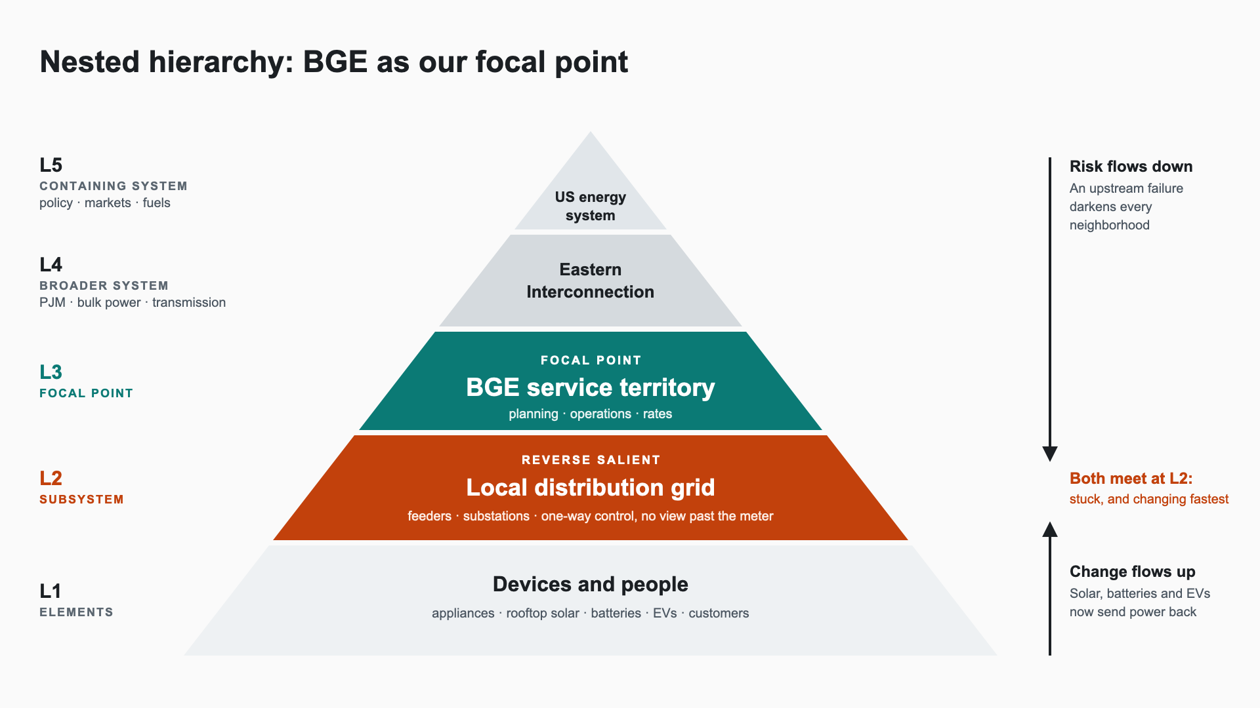

Slide 5
Level 2 is where the grid is stuck, and where it changes fastest
Constraints
What is changing
What is stuck
Resilience: an upstream failure darkens every neighborhood
Last mile untracked: no view past the meter
Microgrids: local cells that can run on their own
Virtual power plants pool home devices
Institutional inertia: replacing infrastructure takes years
Renewables arrive faster than the grid adapts
What if we change one element?
Make each neighborhood a cell that can island itself and share with its neighbors. Utilities then coordinate cells, and devices get a grid that can use them.

Slide 6
A grid of grids: local cells that share power and can island
Coordination software: the CS layer
Each cell balances its own solar, batteries and EVs.
DC links between cells are controllable, so software decides who shares with whom.
A fault stays local: that cell islands and its neighbors keep running.
Homes
Hospital
Campus
Shops
Outage here: cell islands
Factory

Slide 7
Opportunities: Level 2 problems for software
Opportunity | The problem | What cascades
Last-mile visibility Better interactions | Utilities cannot see the solar, batteries and EVs behind the meter | Utilities plan around real local supply. The other two ideas depend on this data.
Virtual power plant orchestration New purpose | Peaks are met by building plants while home batteries and EVs sit idle | Homes become suppliers, and the grid needs fewer peaker plants.
Routing protocol for power Removes a constraint | Nothing decides when a local cell should island, import or export | A failure stays in one cell. Utilities shift from delivering power to coordinating cells.
Open risk: more software on the grid means a larger attack surface.

